Slide 1

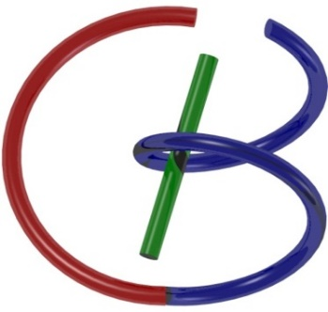
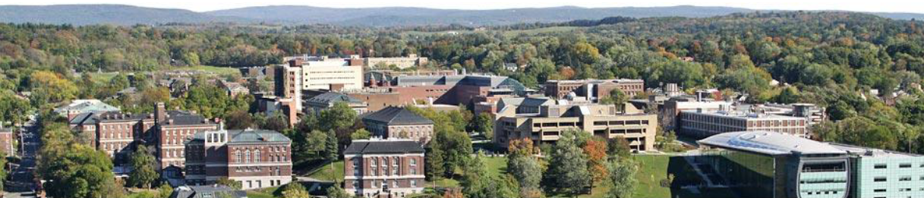
Network Architectures
Ge Wang
AI-based X-ray Imaging System (AXIS) Lab
Rensselaer Polytechnic Institute, Troy, New York, USA
September 14, 2021
Notes:
Hello, since Professor Wang has a conference today out of town, I will give this hands-on introduction based on this PPT we prepared together. As he mentioned last time, we will have deep learning final projects by the end of the semester. Tentatively, we will have five lectures on deep learning hands-on, including this one.

Slide 2
MI Schedule for F21
Tue | Topic | Fri | Topic
08/31 | Introduction | 09/03 | Neuron, Network & Backpropagation
09/07 | No Class | 09/10 | Hands-on 1: Python, Colab, & TensorF
09/14 | Architectures & Training | 09/19 | Hands-on 2: MNIST Classification
09/21 | Image Quality I | 09/24 | CT Physics
09/28 | CT Reconstruction | 10/01 | Deep CT Reconstruction
10/05 | Hands-on 3: CT Networks | 10/08 | More CT Contents
10/12 | MRI Physics | 10/15 | Spin-Echo
10/19 | K-Space Theorem | 10/22 | More MRI Contents
10/26 | Mid Exam | 10/29 | Deep MRI Reconstruction
11/02 | Hands-on 4: MRI Networks | 11/05 | Nuclear Physics
11/09 | Nuclear Imaging | 11/12 | US Imaging
11/16 | Optical Imaging | 11/19 | Multimodality Imaging
11/23 | Hands-on 5: Image Conversion | 11/26 | Thanksgiving
11/30 | Image Quality II | 12/03 | Stability, Interpretability, & Others
12/07 | Overview | 12/10 | Final Exam
Office Hour: Teaching Day 5-6pm: https://rensselaer.webex.com/meet/wangg6

Slide 3
Homework: Going through PreLab
Preview: Hands-on #1 in my dropbox https://www.dropbox.com/home/MIMI-F21
If you cannot access the dropbox, please email me.
Open Google Colab in a web browser:
https://colab.research.google.com/notebooks/basic_features_overview.ipynb
Go to ‘File-->Upload Notebook‘;
Select 'Hands_On_1_PreLab.ipynb' in the dialogue box;
Please put a white square in the CT image and write a complete report showing your work step by step.
Homework Rule: Name your homework report in the format MI_Date_Name, where “Date” specifies when the lecture was delivered, and “Name” is your initials+last name. Please convert your homework report into PDF, update to LMS regularly (5 working days after assignment), and submit an integrated single PDF before the final exam.

Slide 4
Hands-on Announcement
All hands-on files shared via Google Drive & executed in Google Colab
You need to use your Gmail account
Visit Chris’ dedicated teaching drive for MIMI-F21:
https://drive.google.com/drive/folders/17k_O0SEuI_JGKLv5PCbffYiV0Nvp_y5Z
For example, all files for Hands-on 1:
You can go to the sub-folder “hands_on_1”, or click
https://drive.google.com/drive/folders/1-1D-wHOn1Z_WZTx2p-WEZC01_vEivzlv?usp=sharing
View the README
Run the Prelab code with Google Colab
Watch the lecture video

Slide 5
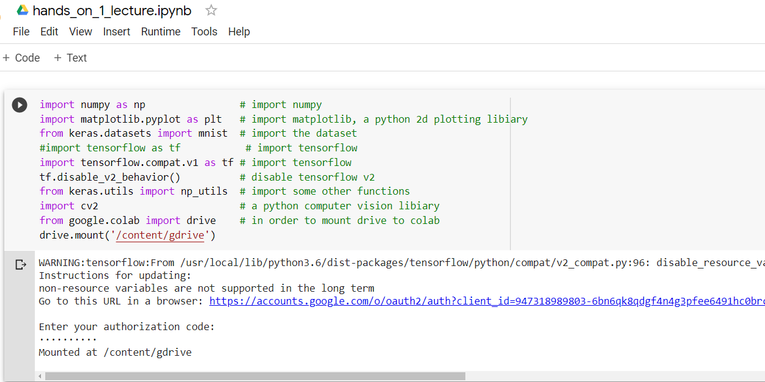
Linking Colab & Google Drive
You must upload data to your google drive so that you can read in the Jupyter notebook. Please mount your gdrive to Colab!

Slide 6
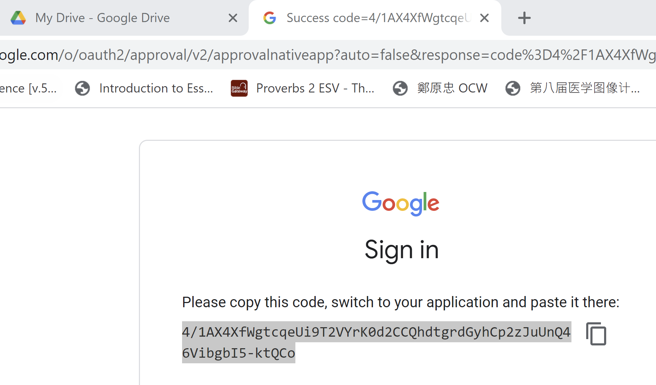

Slide 7
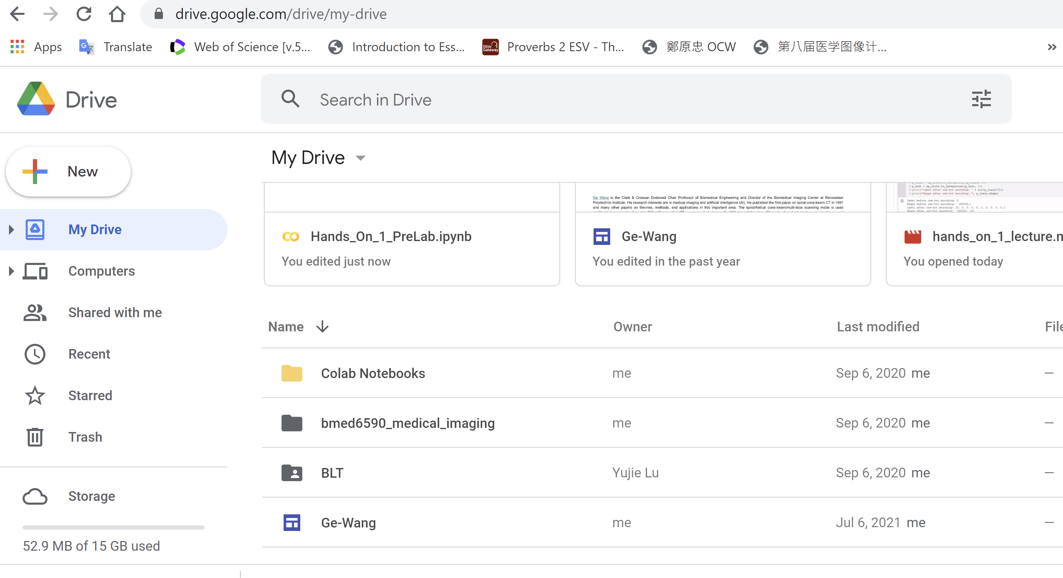

Slide 8
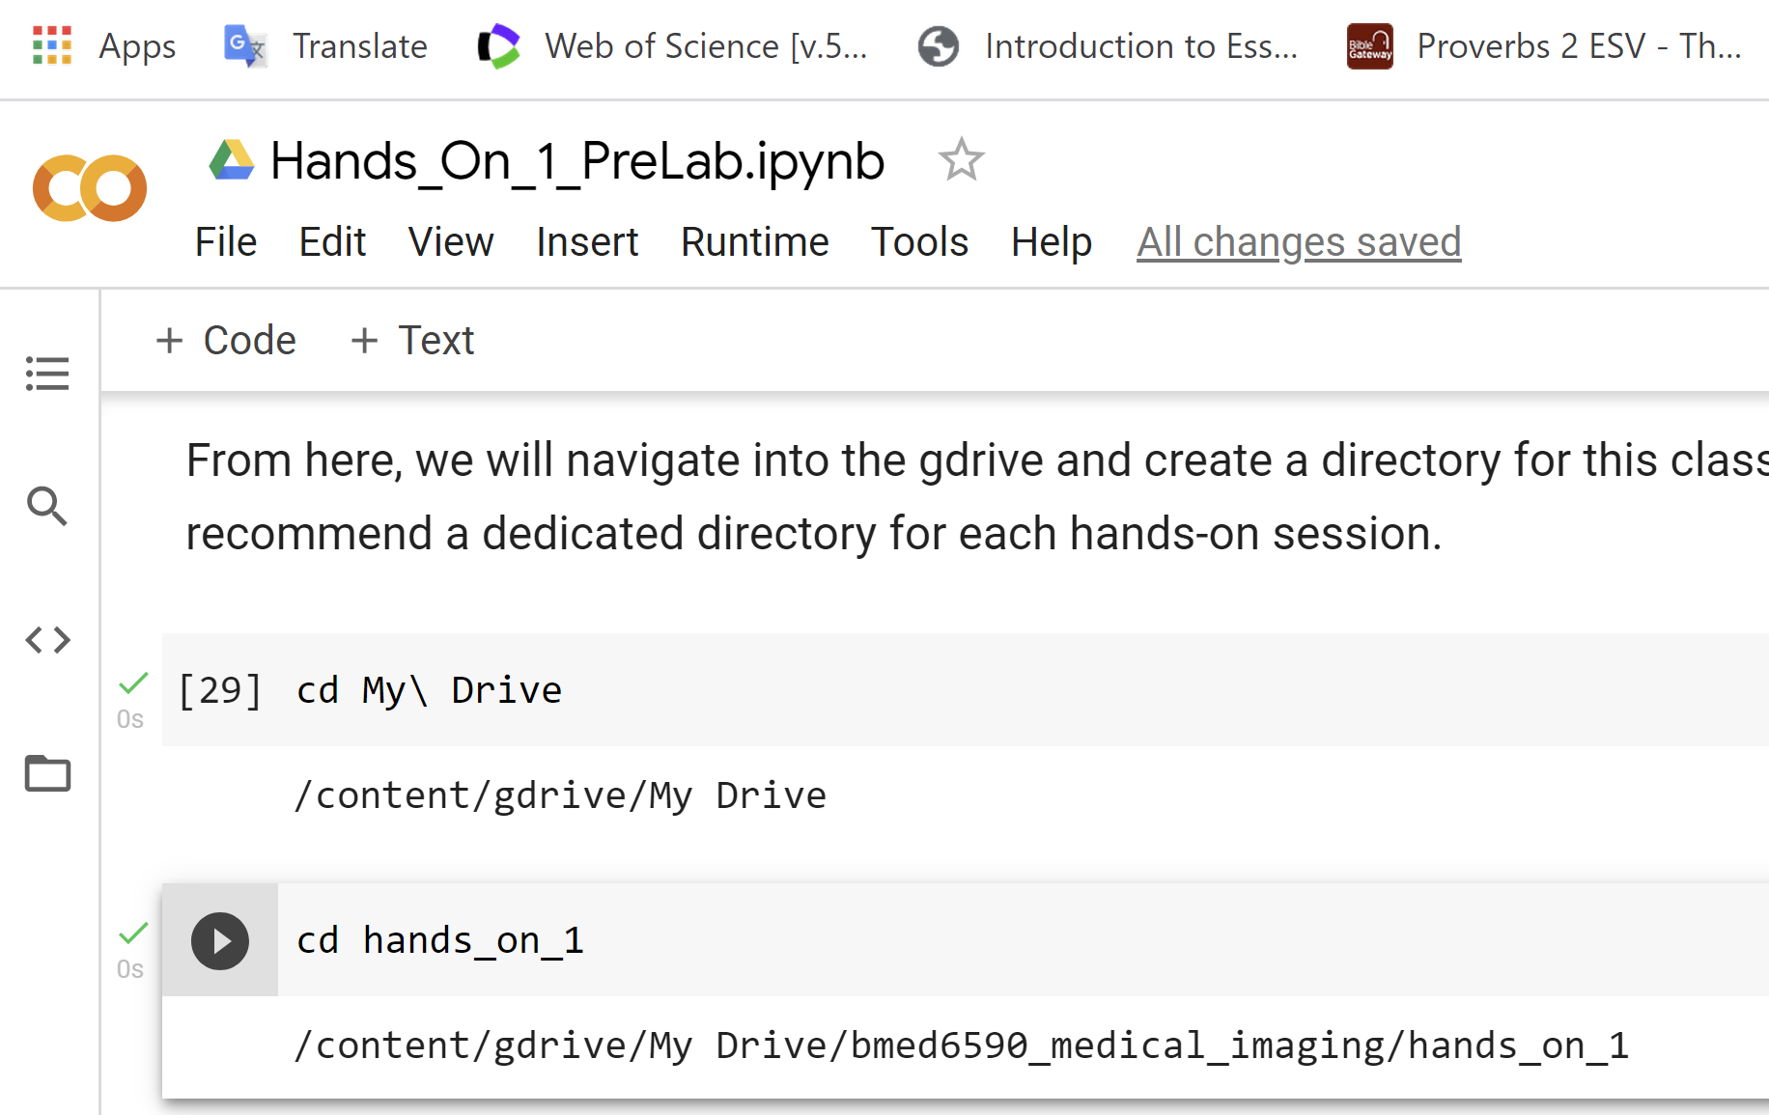

Slide 9
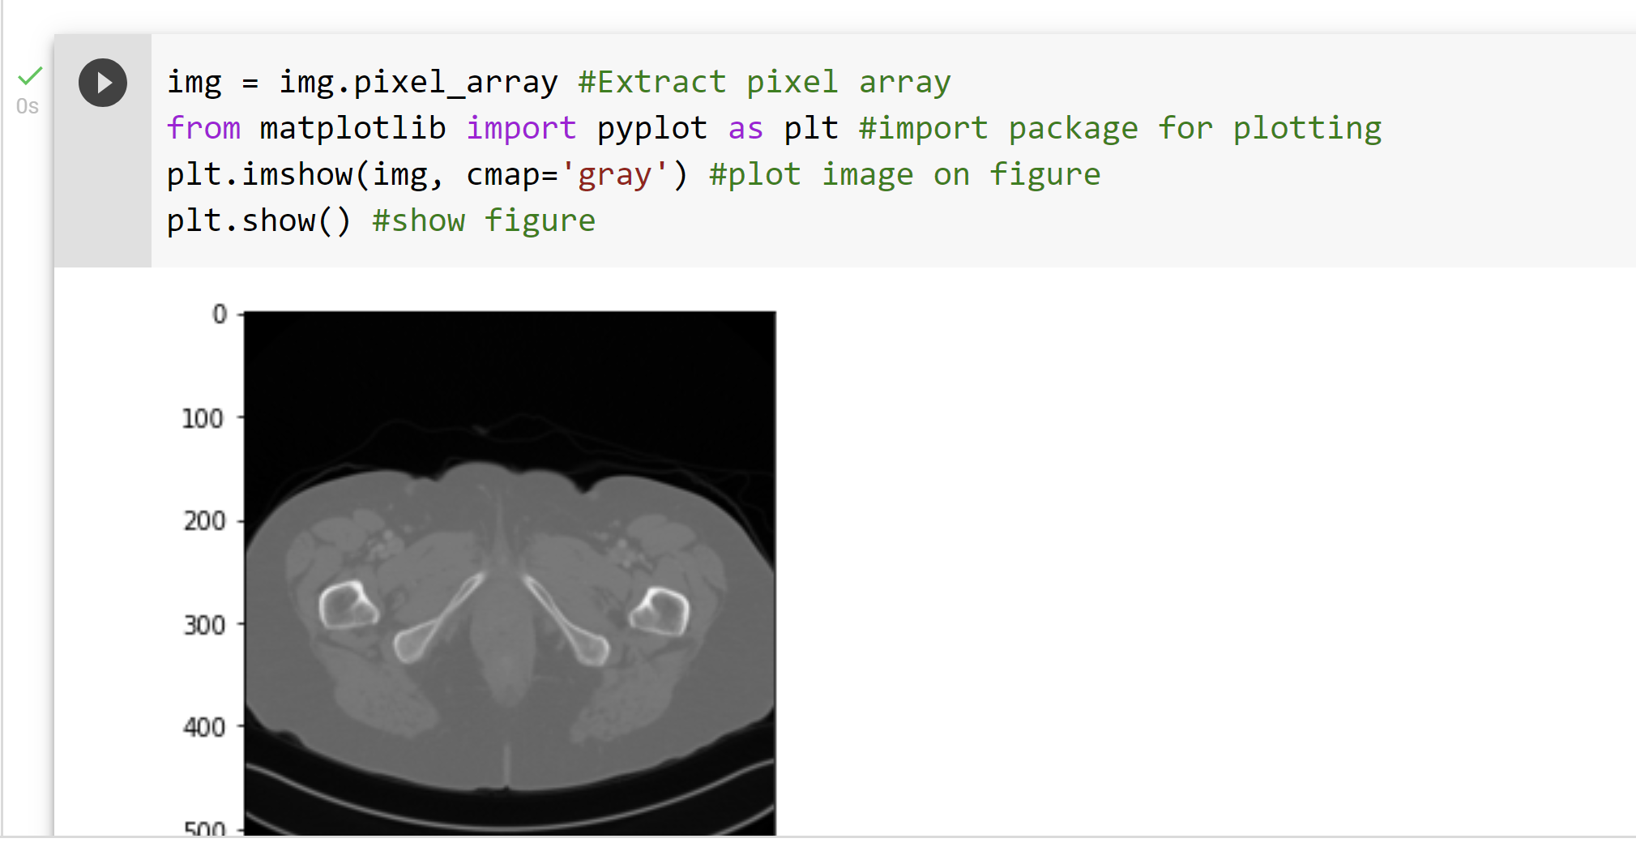

Slide 10
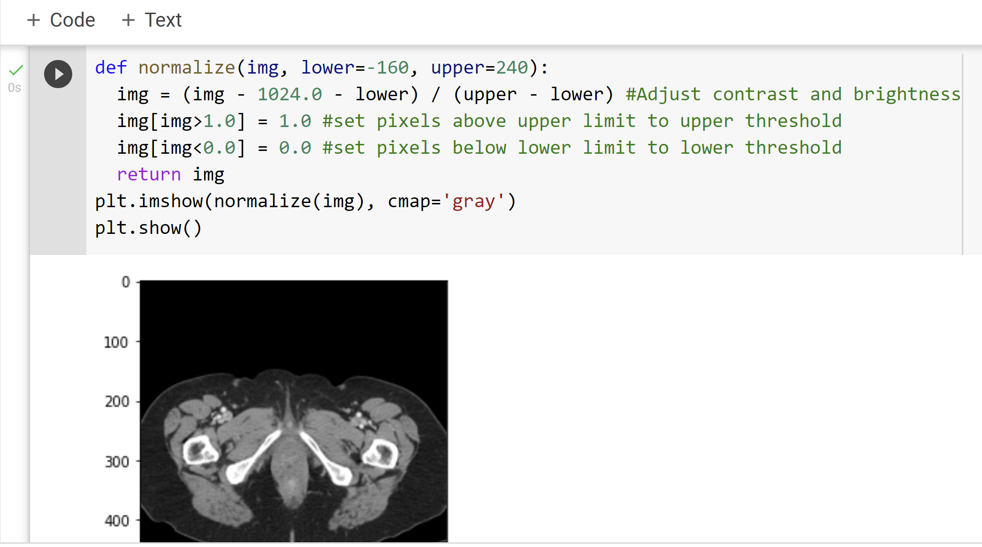
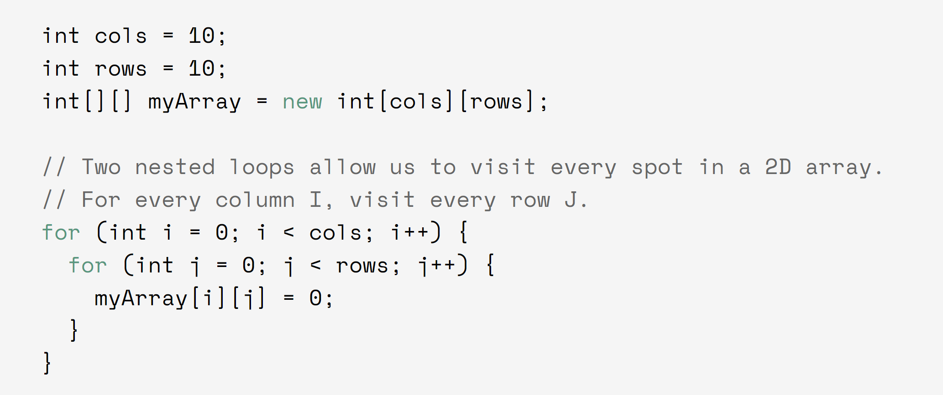

Slide 11
Outline
Overall Idea
Basic Forms
Softmax, Feedforward, CNN
More Advanced Designs
AE, U-Net, ResNet, GAN

Slide 12
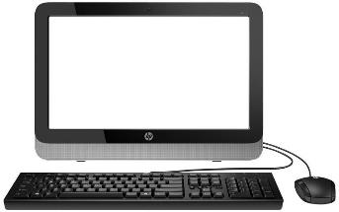
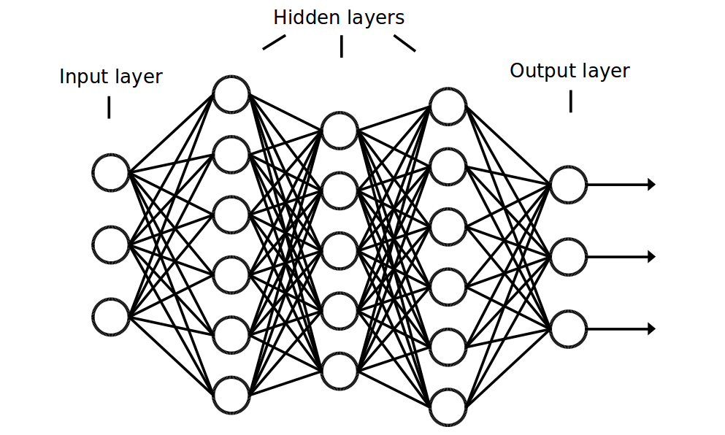
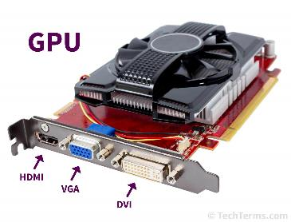
Programming vs Data-driven Learning
Data
Output
Program
Data
Output
Training
Data
Program
Output

Slide 13
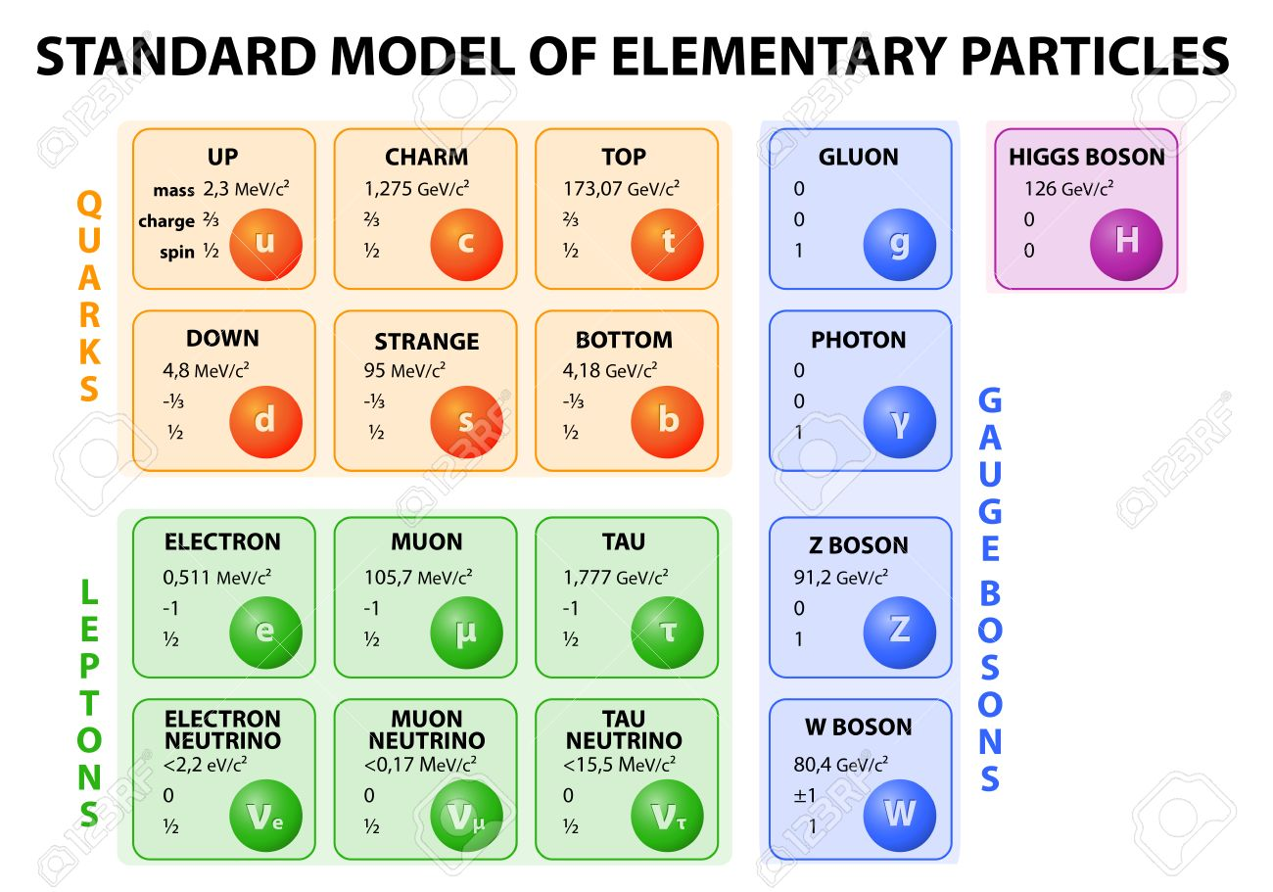
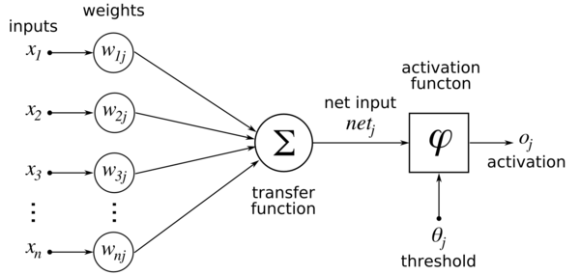
Basic Unit: Artificial Neuron

Slide 14
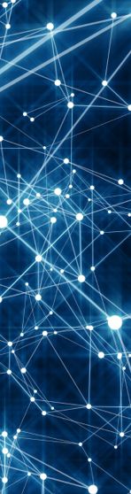
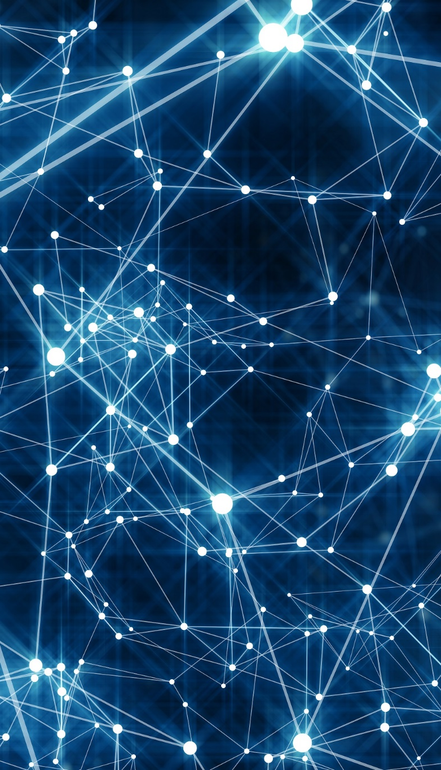
Not All Configurations Insightful/Useful
Key Insights
Convolutional Operation (Linear System)
Multi-scale Analysis (Wavelet Transform)
Shortcut/Feedback (Control Theory)
Adversarial Mechanism (Game Theory)
Amplitude/Phase (Complex Analysis)
… …

Slide 15
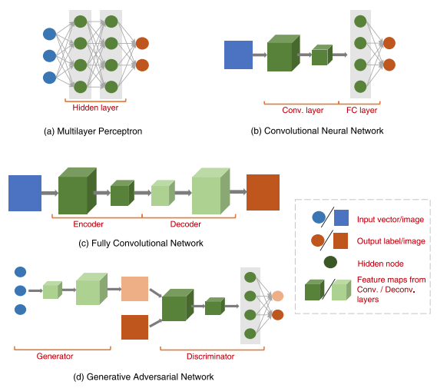
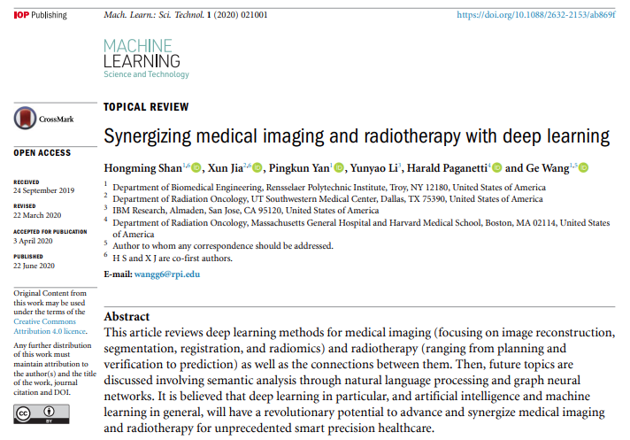
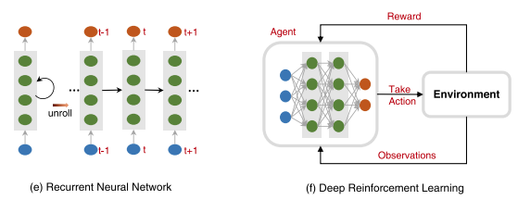
https://iopscience.iop.org/article/10.1088/2632-2153/ab869f

Slide 16
Outline
Overall Idea
Basic Forms
Softmax, Feedforward, CNN
More Advanced Designs
AE, U-Net, ResNet, GAN

Slide 17
Feed Forward 5-Layer Network for 3 Classes
a
X=(x₀, x₁, …, x_{n})’
b
c
Data
Output
Training

Slide 18

Sigmoid vs ReLU
Sigmoid is theoretically well motivated, differentiable, and extensively studied but it is subject to the gradient diminishing problem. ReLU is computationally easy, practically attractive and becomes popular now.

Slide 19
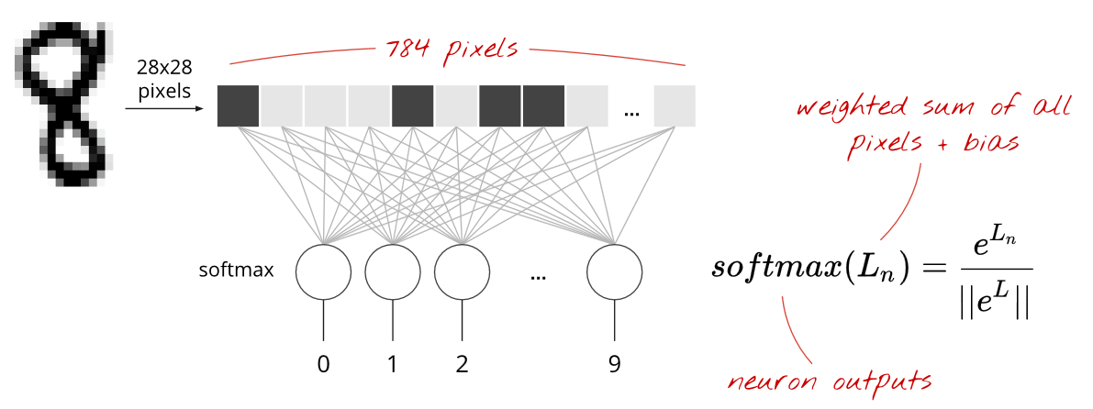
Feed Forward 1-layer Network for 10 Classes
https://cloud.google.com/blog/products/gcp/learn-tensorflow-and-deep-learning-without-a-phd

Slide 20
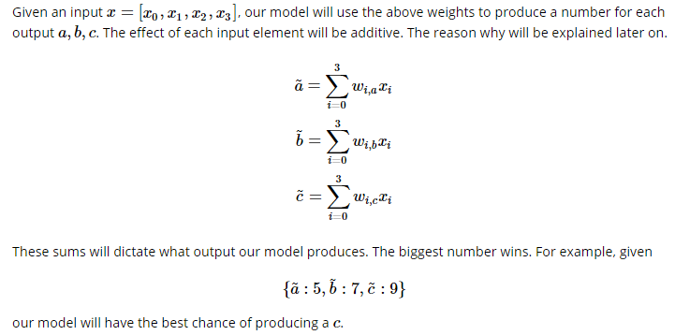
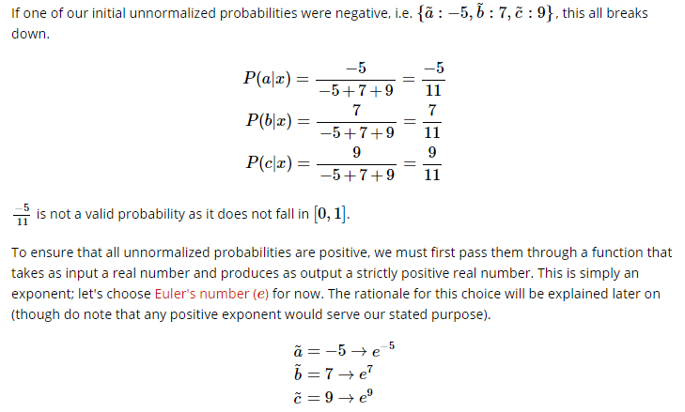
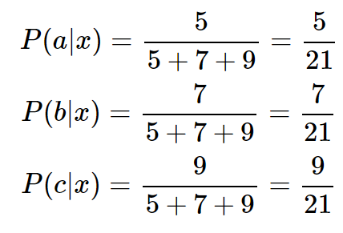
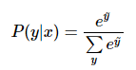
Derivation of Softmax Function
These pseudo likelihood values are again in a relative sense!
Note -5, 7, -2 will make the denominator 0
These pseudo likelihood values are in a relative sense! –
We can set one as ground 0
Make sure non-negative
We can normalize these likelihood values to produce probabilities.
http://willwolf.io/2017/04/19/deriving-the-softmax-from-first-principles/

Slide 21
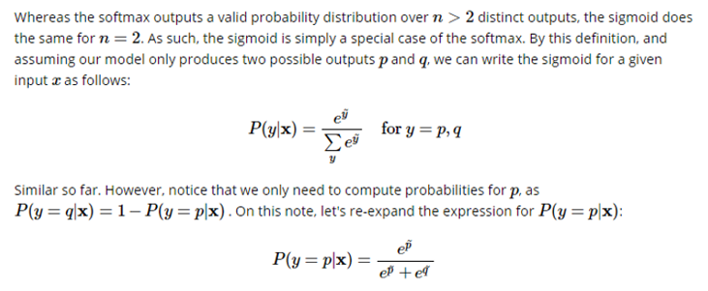
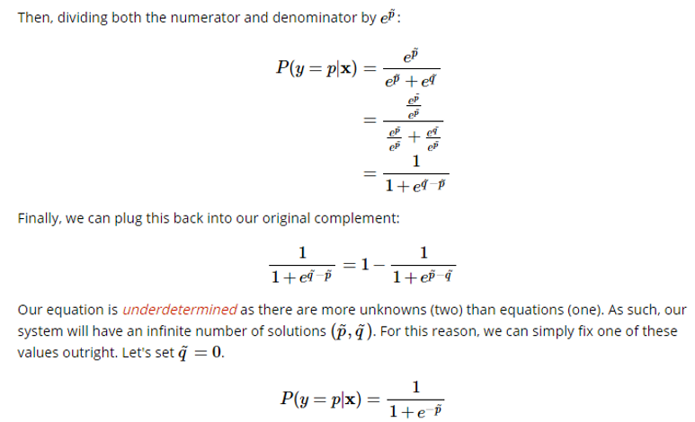
Derivation of Sigmoid Function

Slide 22
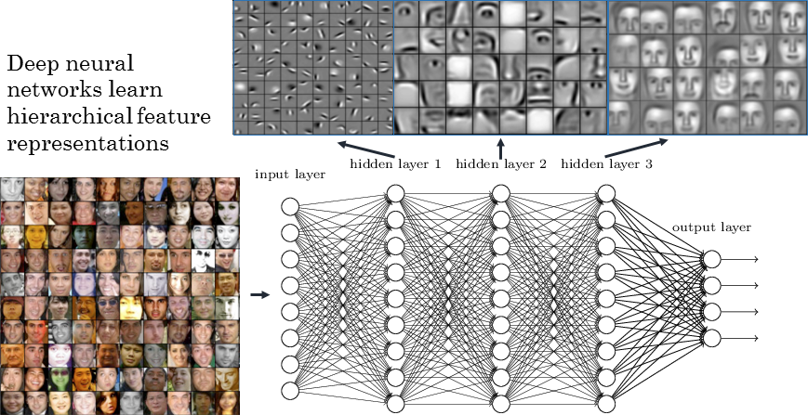
CNN: Face Recognition

Slide 23
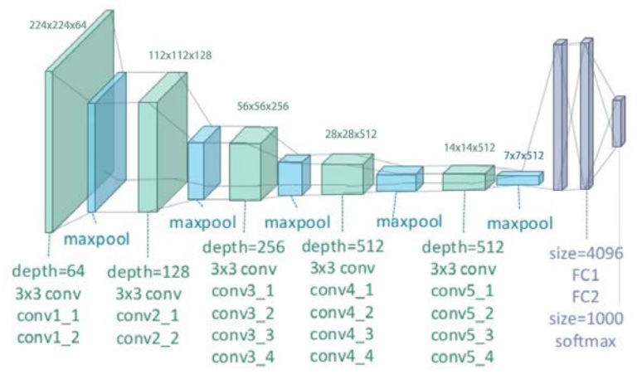
CNN: Breast Cancer Screening
file:///C:/Users/wangg6/Downloads/Breast_cancer_screening_using_convolutional_neural.pdf

Slide 24

Convolutional Layer
https://stats.stackexchange.com/questions/142606/receptive-field-of-neurons-in-lenet

Slide 25
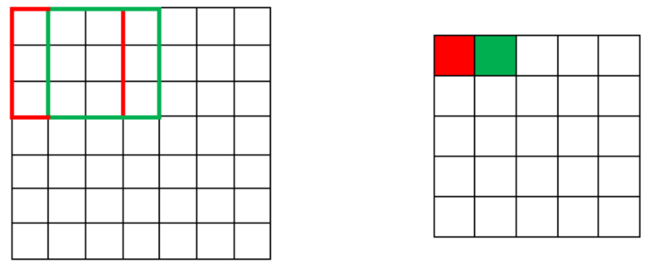
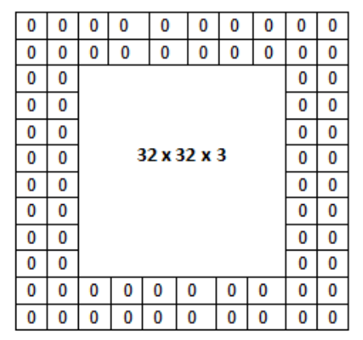
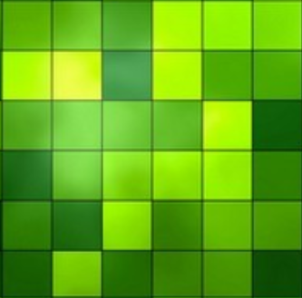
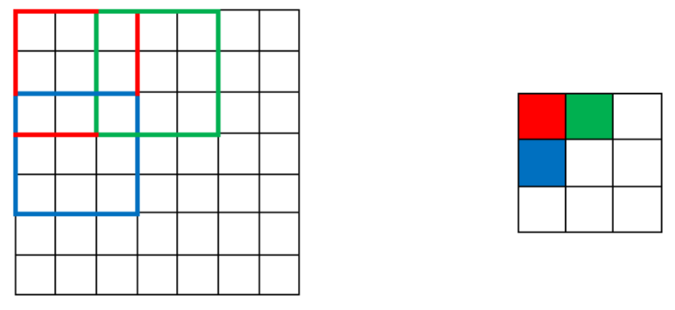
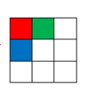
Stride & Padding

Slide 26
Outline
Overall Idea
Basic Forms
Softmax, Feedforward, CNN
More Advanced Designs
AE, U-Net, ResNet, GAN

Slide 27
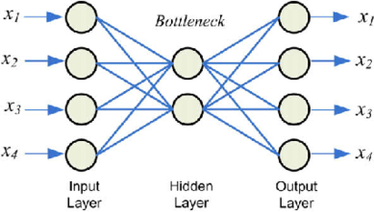
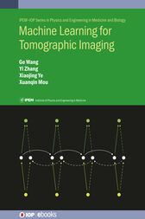
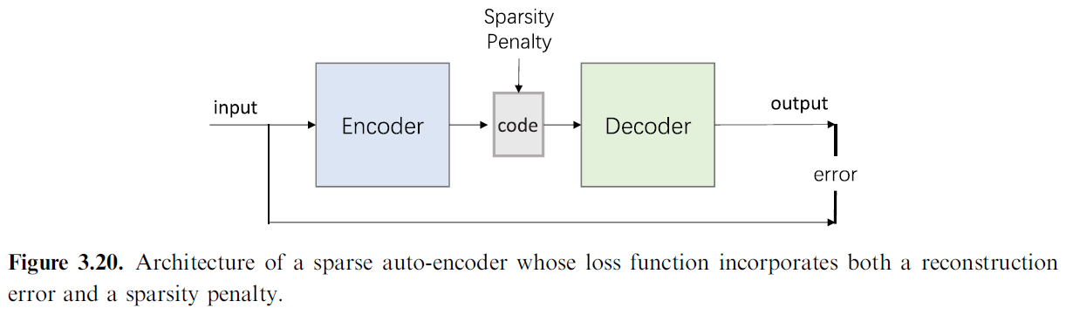
Auto-encoder

Slide 28
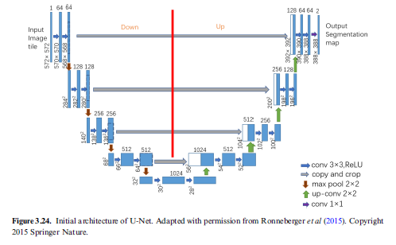
U-Net
Concatenation

Slide 29
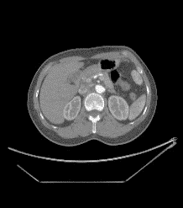
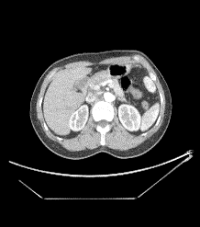
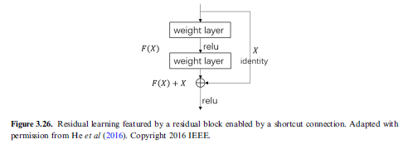
Res-Net
Linear
Quadratic
Conv+ReLU
Residual Block
Residual Block
Conv+ReLU
• • •
Conv+ReLU
Cubic
Conv+ReLU
Conv+ReLU
Conv+ReLU
Summation

Slide 30
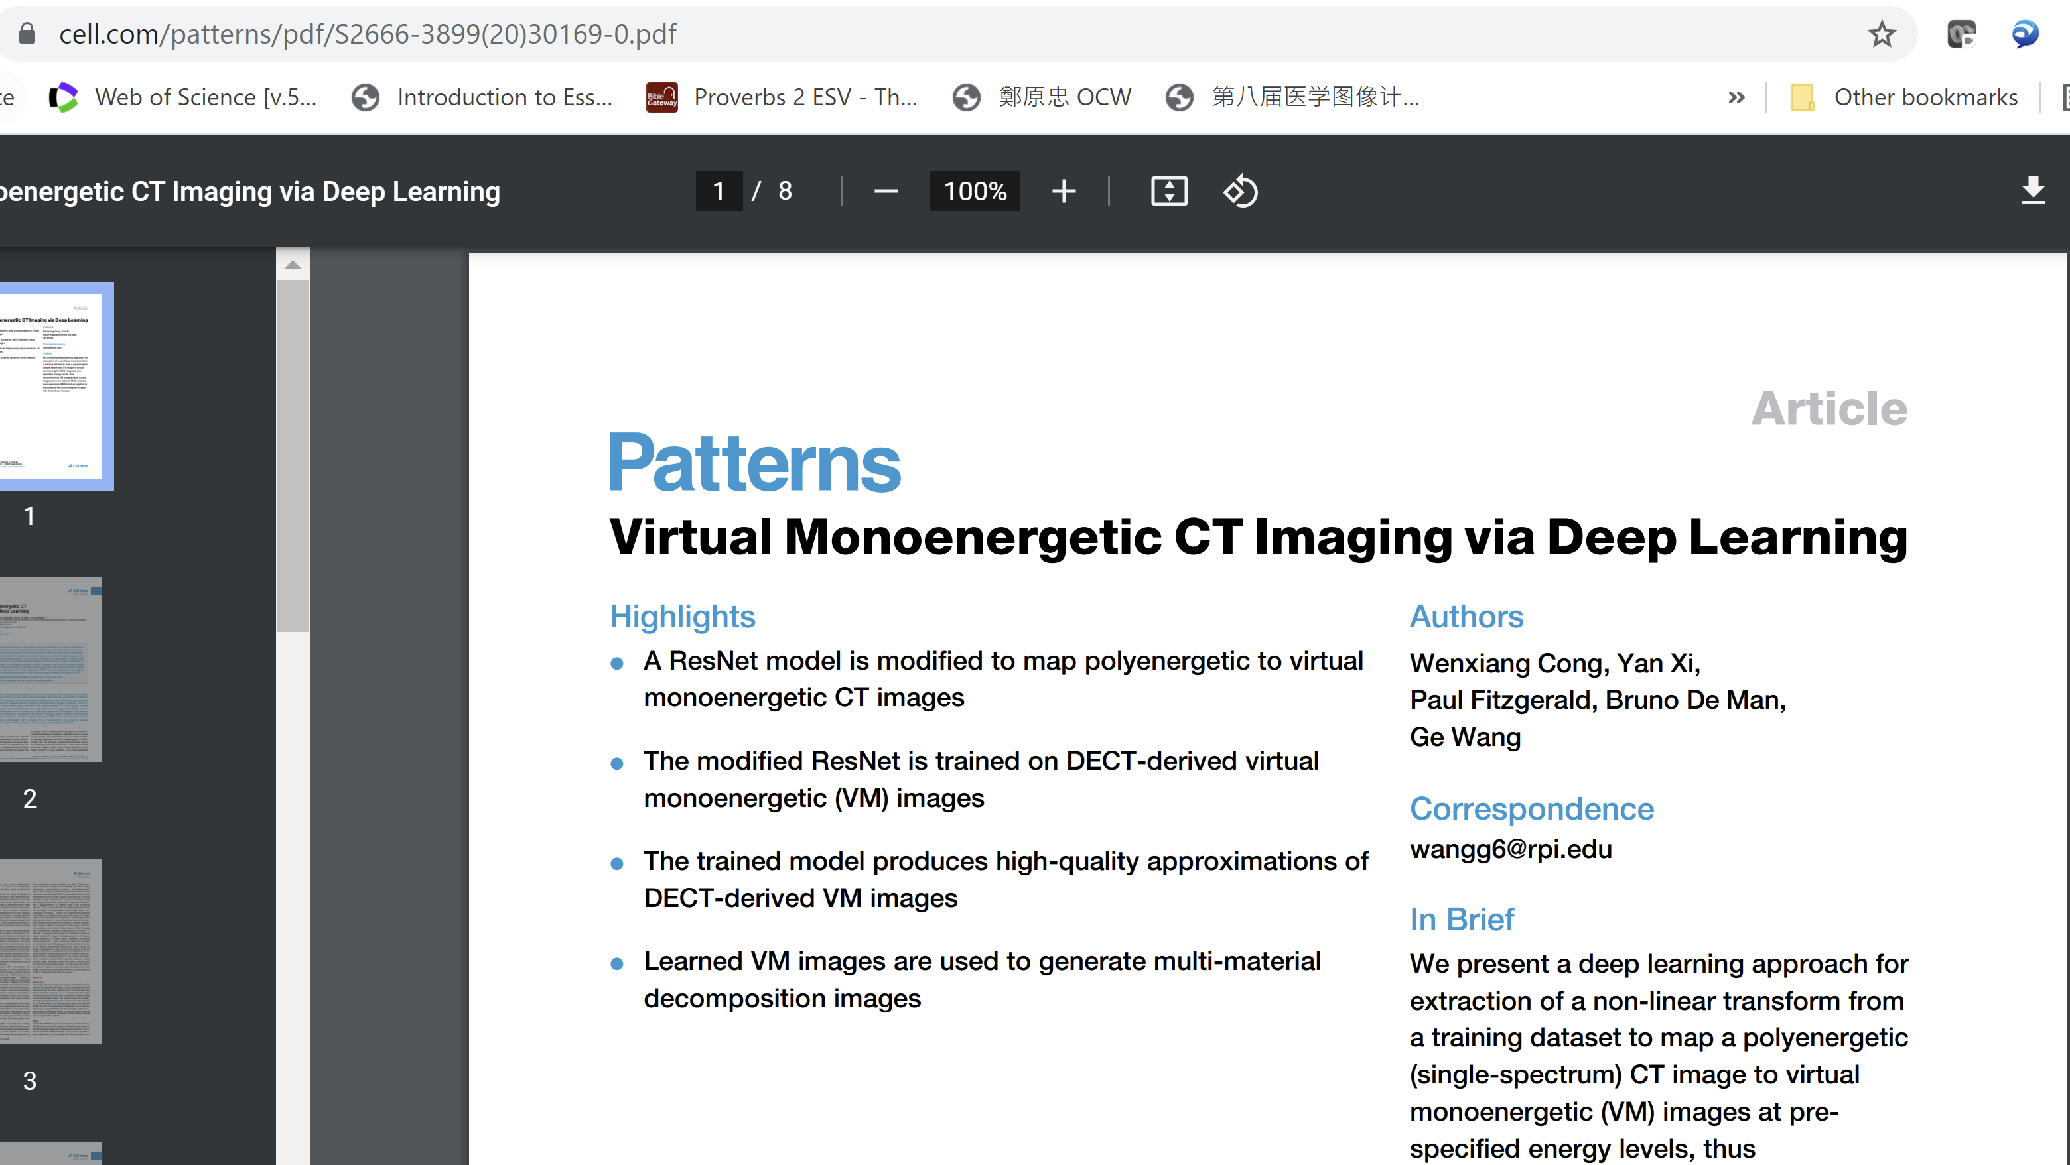

Slide 31
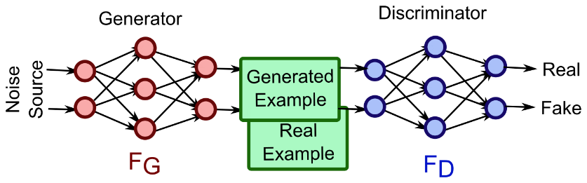
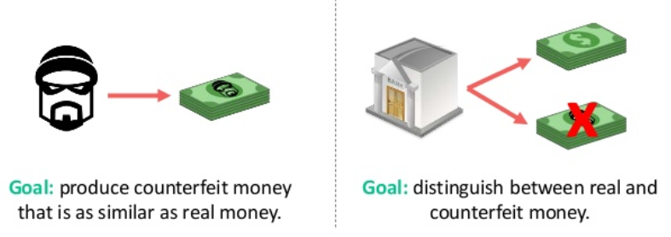
Generative Adversarial Network (GAN) Idea

Slide 32
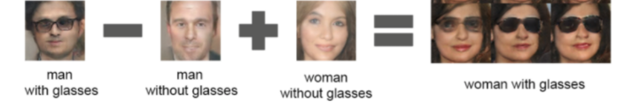
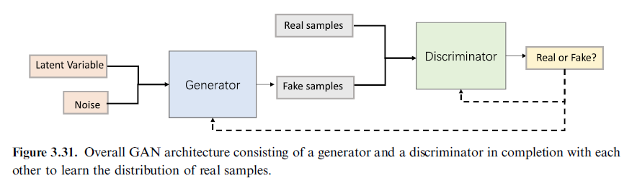
GAN Workflow
https://www.kdnuggets.com/2017/11/infogan-generative-adversarial-networks-part3.html

Slide 33
GAN Training
+
Tuning
Real
Network Output
Input
Generator
Discriminator
Loss
Ground Truth
Synthetic
Tuning

Slide 34
One-dimensional Example
Discriminator
Generator

Slide 35
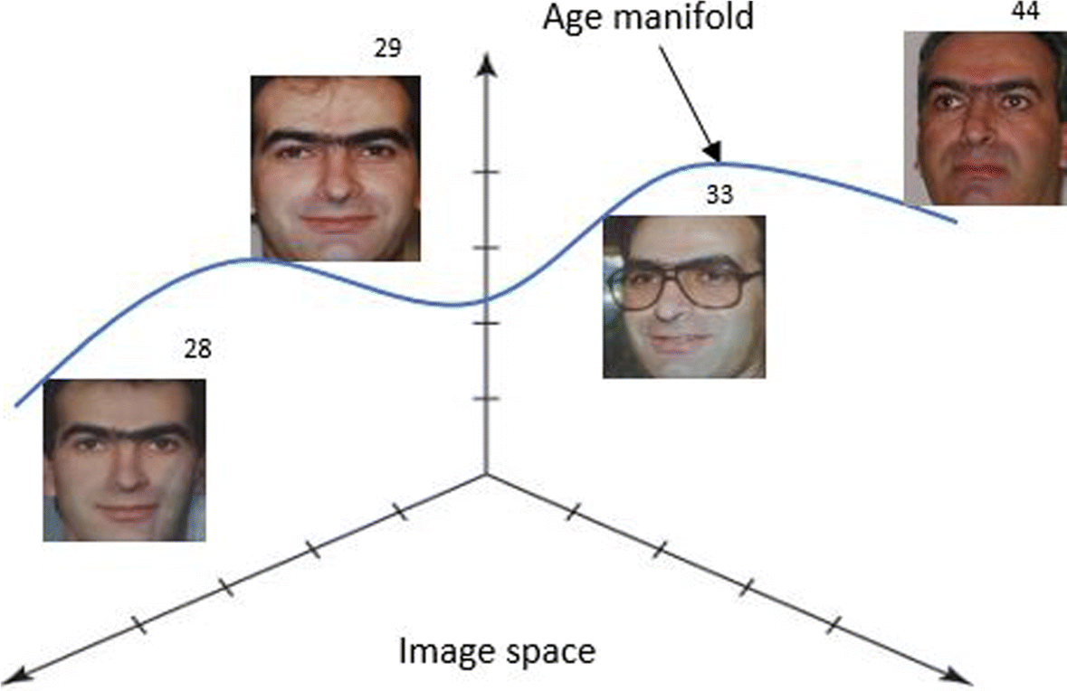
Adversarial Learning
1.0
0.5
Frequency
Synthetic/
Source/Fake Distribution
Data/
Target/Real Distribution
Data

Slide 36
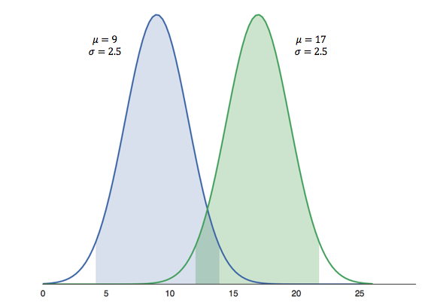
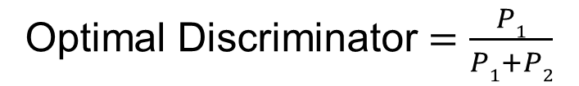
Optimal Discriminator
Optimal Discriminator $=\frac{P1}{P1+P2}$
P₁
P₂
For a new datum, if discriminator function is greater than 0.5, the datum should belong to Class 1 (blue); otherwise, it comes more likely from Class 2 (green)

Slide 37
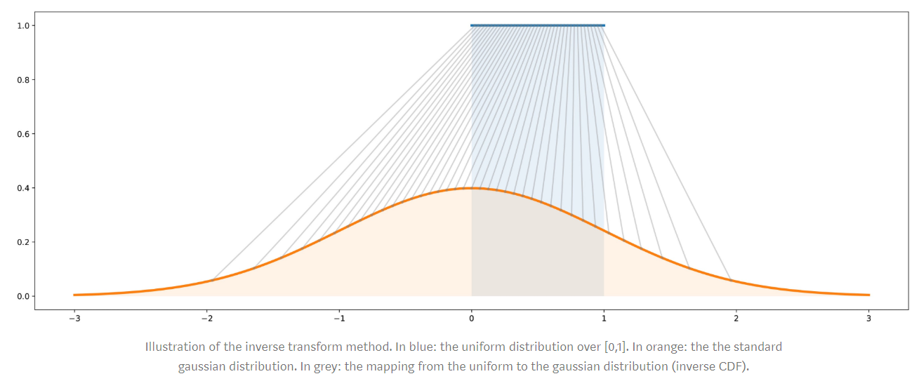
Optimal Generator
p₁
p₂
https://towardsdatascience.com/understanding-generative-adversarial-networks-gans-cd6e4651a29

Slide 38
Initial Interplay
1.0
1.0
1.0
0.5
0.5
0.5
Frequency
Likelihood
Data
Improve Generator
Data
Improve Discriminator
Data

Slide 39
Further Improvement
1.0
1.0
1.0
0.5
0.5
0.5
Frequency
Likelihood
Data
Improve Generator
Data
Improve Discriminator
Data

Slide 40
Homework
Hands-on 1: Alter aspects of the neural network, data, etc. and report the results. Try to achieve a superior network performance. Some ideas for alteration:
Network architecture (neurons, layers)
Network activation function(s)
Learning Rate
Number of epochs/batch sizes
Optional Problem
https://gertjanvandenburg.com/blog/autoencoder/
In reference to the above link, please develop a simple MNIST autoencoder in Colab/TensorFlow

